Slide 1
Structure of Fibonacci heaps, potential function
By
Mr. GURURAJ
Assistant Professor-Selection Grade
Department of Computer Science & Engineering
M.I.T Manipal

Slide 2
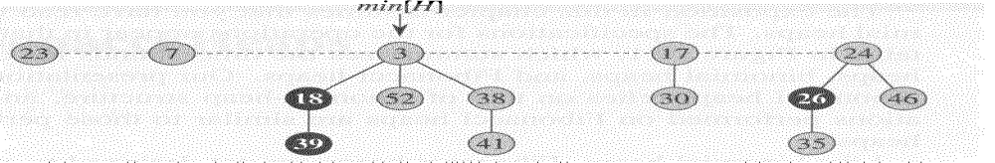
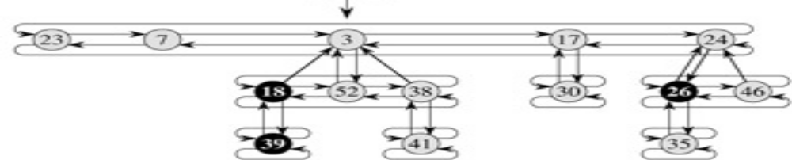
Structure of Fibonacci heaps
Complete Representation –Fibonacci Heap

Slide 3
Fibonacci Heap
Each node x contains a pointer p[x] to its parent and a pointer child[x] to any one of its children.
The children of x are linked together in a circular doubly linked list, which we call the child list of x.
Each child y in a child list has pointers left[y] and right[y] that point to y's left and right siblings, respectively.
If node y is an only child, then left[y] = right[y] = y.
The order in which siblings appear in a child list is arbitrary.

Slide 4
Fibonacci Heap
Advantages of circular doubly linked list
we can remove a node from a circular, doubly linked list in O(1) time.
given two such lists, we can concatenate them into one circular doubly linked list in O(1) time.
The number of children in the child list of node x is stored in degree[x].
The boolean-valued field mark[x] indicates whether node x has lost a child.
Newly created nodes are unmarked, and a node x becomes unmarked whenever it is made the child of another node.

Slide 5
Fibonacci Heap
A given Fibonacci heap H is accessed by a pointer min[H] to the root of a tree containing a minimum key; this node is called the minimum node of the Fibonacci heap.
If a Fibonacci heap H is empty, then min[H] = NIL.
The roots of all the trees in a Fibonacci heap are linked together using their left and right pointers into a circular, doubly linked list called the root list of the Fibonacci heap.
The pointer min[H] thus points to the node in the root list whose key is minimum. The order of the trees within a root list is arbitrary.
n[H] -the number of nodes currently in H.
t[H]- the number of trees in the root list of H .
m(H) -the number of marked nodes in H.

Slide 6
Fibonacci Heap-Potential function
The potential of Fibonacci heap H is then defined by

